Slide 1
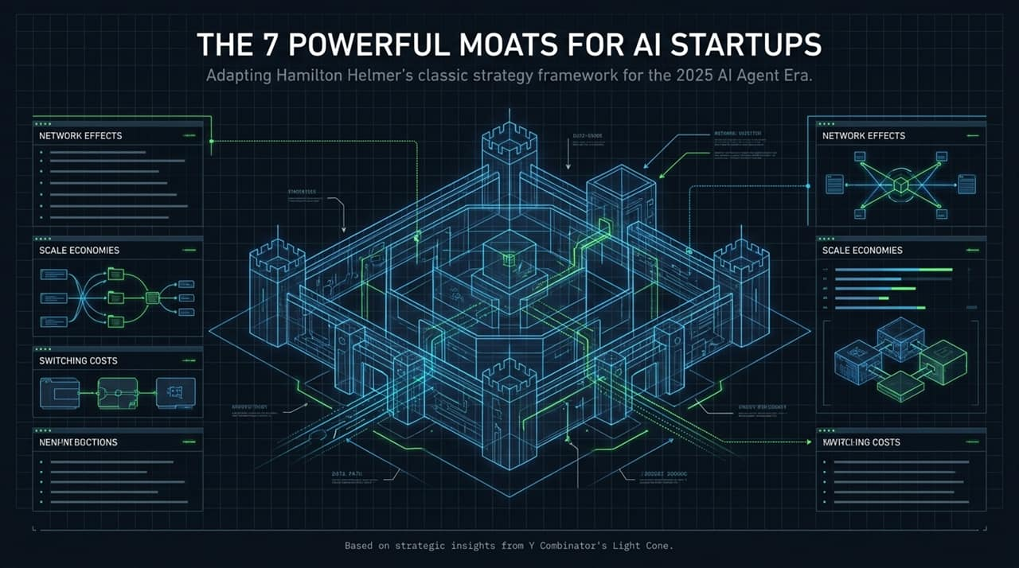
Notes:
Welcome everyone. Today, we are exploring a question that dominates every founder's and investor's mind in the generative AI era: How do AI startups build lasting defensibility?
This presentation adapts Hamilton Helmer’s classic business strategy framework—7 Powers—specifically for the 2025 AI Agent landscape.
We'll draw on real-world lessons and tactical insights from Y Combinator’s Light Cone to unpack how traditional moats are evolving and where true defensibility comes from today.
https://www.youtube.com/watch?v=bxBzsSsqQAM

Slide 2
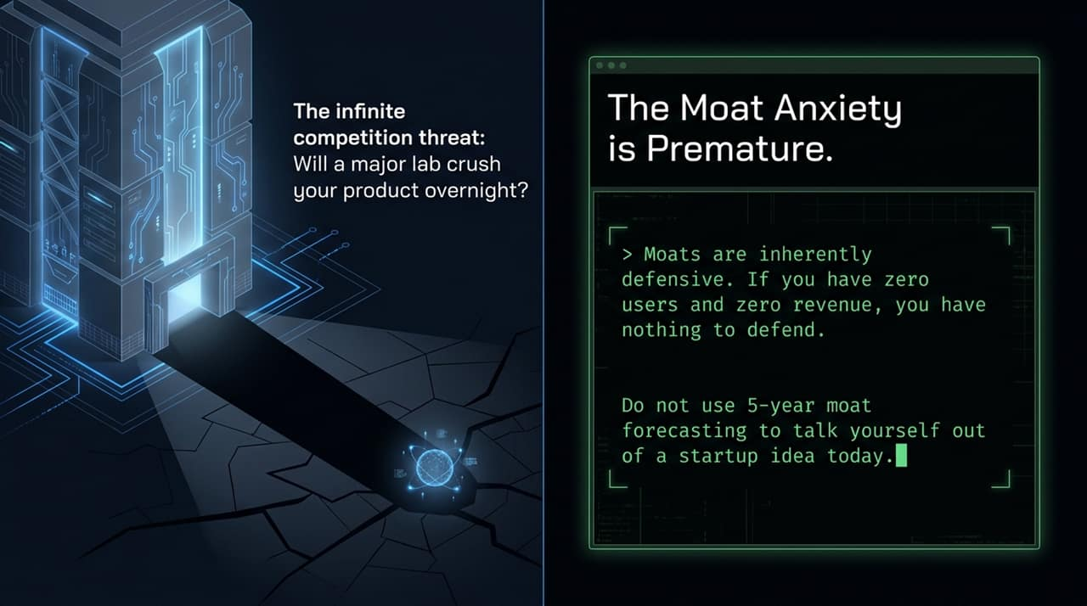
Notes:
Before diving into frameworks, we must address a common trap: "Moat Anxiety." Many founders get stuck worrying that a major lab (like OpenAI or Anthropic) will release a feature tomorrow that instantly crushes their product.
However, as YC partner Gary Tan emphasizes: A moat is inherently defensive. If you have zero users and zero revenue, you have literally nothing to defend.
Stop using 5-year moat forecasting to talk yourself out of launching a startup today. First, find a customer with acute pain, solve it, and build something valuable enough that it actually needs defending.

Slide 3
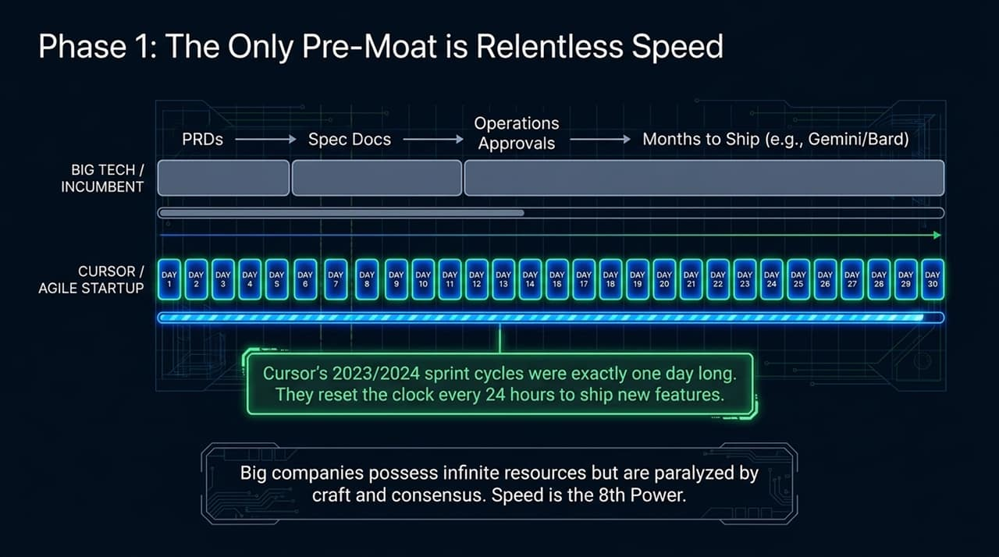
Notes:
In the 0-to-1 phase, traditional moats don't apply. The only real moat early on is Speed—what YC calls the "8th Power."
Look at this comparison: Big Tech incumbents have infinite capital and engineering resources, but they are paralyzed by consensus, PRDs, spec reviews, compliance, and long release cycles (taking months to ship updates like Gemini/Bard).
Contrast that with Cursor in 2023/2024: Their sprint cycle was literally 24 hours long. Every single day they reset the clock to ship new features. Startups win early by out-executing incumbents before they can even navigate their internal approvals.

Slide 4
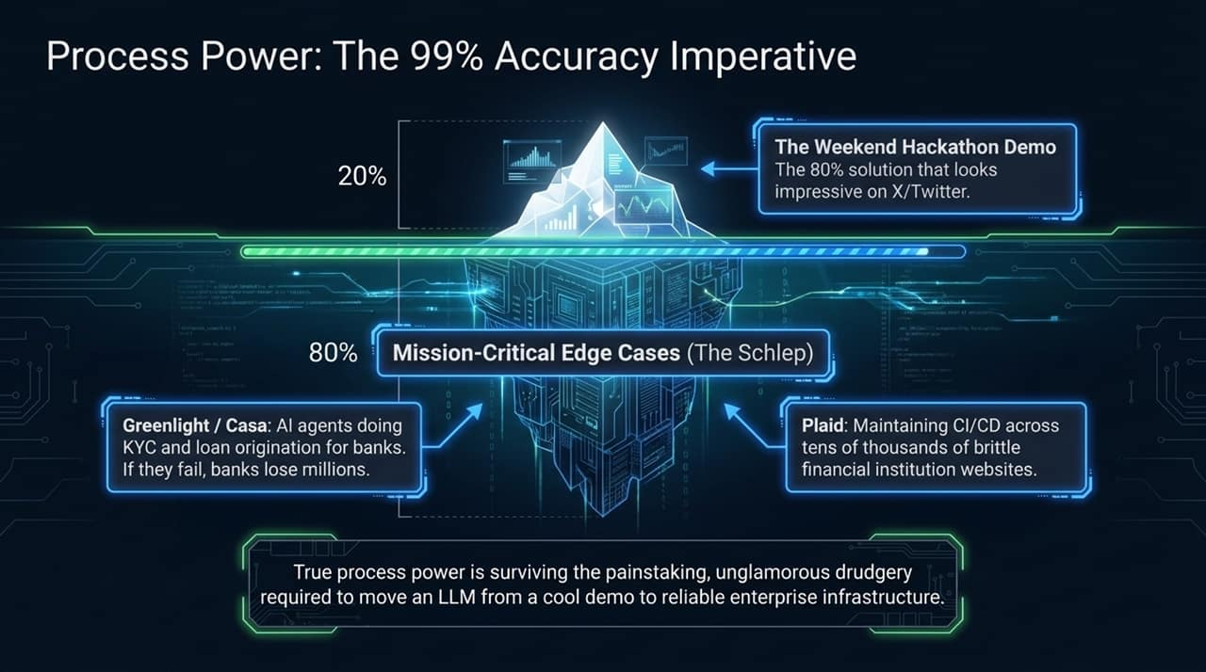
Notes:
As you transition past 0-to-1, you build Process Power.
The top 20% of product development is the "Weekend Hackathon Demo"—the slick 80% solution that looks incredible on X/Twitter. But in the real world, an 80% reliable LLM application is completely useless to an enterprise.
True process power is surviving "The Schlep"—doing the painstaking, unglamorous engineering needed to go from 80% to 99%+ accuracy.
Examples: Greenlight (KYC for banks) and Casa (loan origination). If their AI agents make a mistake, banks lose millions. Or look at Plaid, which maintains complex integration scripts across tens of thousands of brittle bank websites. Big model labs won't waste time tackling these hyper-niche, painful edge cases—giving startups deep defensibility.

Slide 5
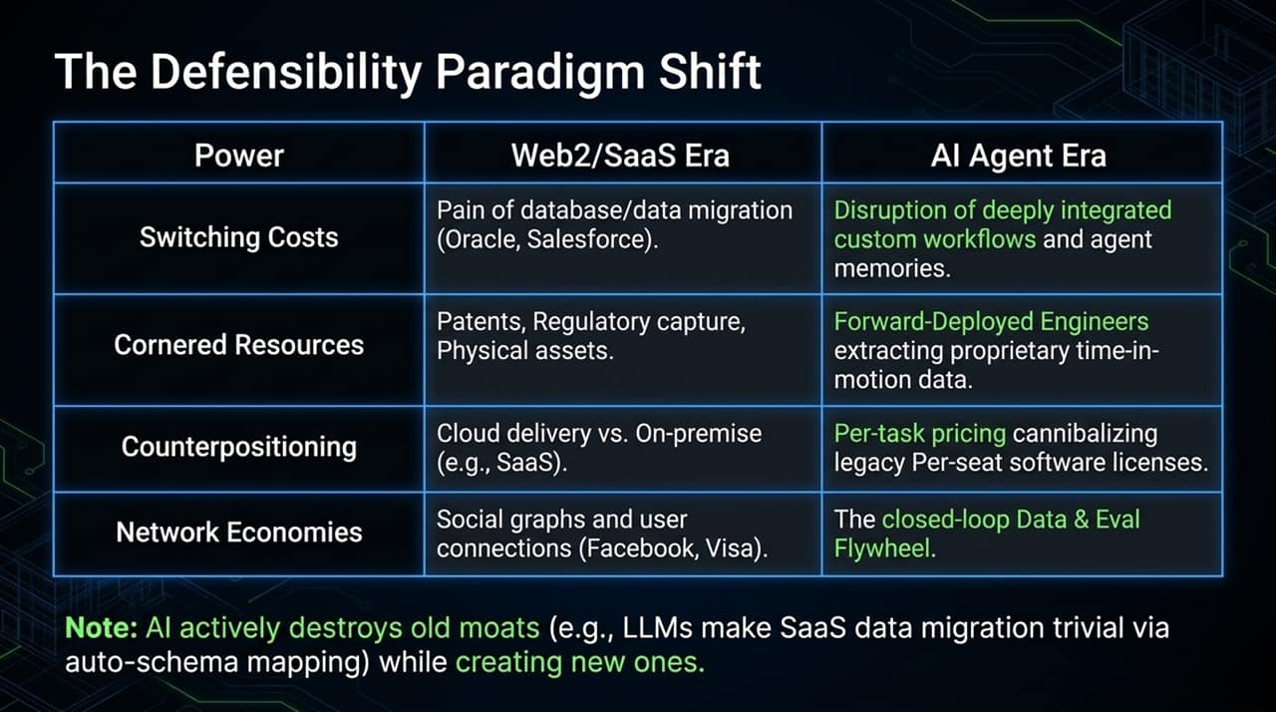
Notes:
AI is fundamentally reshaping Helmer's 7 Powers framework. AI destroys traditional SaaS moats while opening up brand new forms of defensibility:
Switching Costs: Old SaaS relied on painful database migrations (Oracle/Salesforce). AI destroys this because LLMs auto-map data schemas effortlessly. The new switching cost is deeply integrated custom workflows and agent memory.
Cornered Resources: Shifted from physical assets/patents to Forward-Deployed Engineers extracting proprietary operational data.
Counterpositioning: Shifted from Cloud vs. On-premise to outcome/per-task pricing cannibalizing legacy per-seat software licenses.
Network Economies: Shifted from social networks (Facebook/Visa) to closed-loop Data & Eval flywheels.

Slide 6
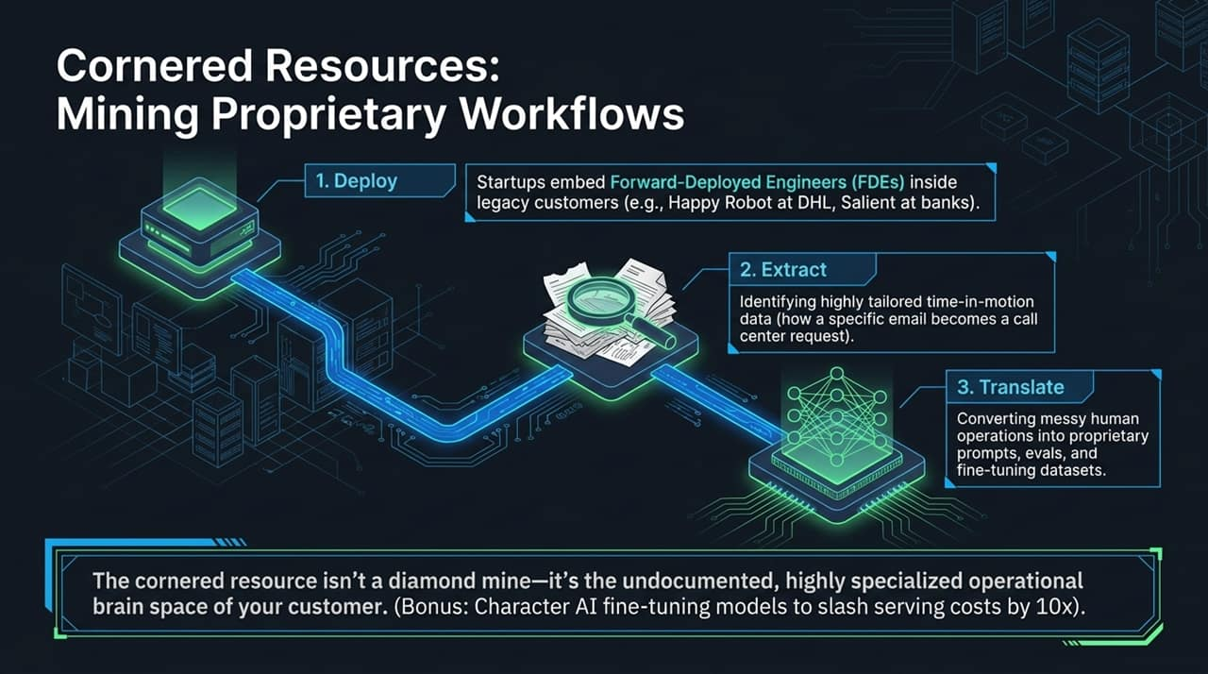
Notes:
What is a Cornered Resource in the AI era? It isn't a patent or a diamond mine—it’s the undocumented, highly specialized operational brain space of your customer.
Modern AI startups deploy Forward-Deployed Engineers (FDEs) directly into client environments (e.g., Happy Robot embedded at DHL, or Salient at enterprise banks).
The FDE methodology follows three steps:
Deploy: Sit directly with human operators.
Extract: Capture granular "time-in-motion" data (e.g., observing how an incoming email gets converted into a call center ticket).
Translate: Convert messy human operations into proprietary prompts, evals, and fine-tuning datasets.
Once you corner this operational context, no competitor or generic LLM can replicate your domain performance.

Slide 7
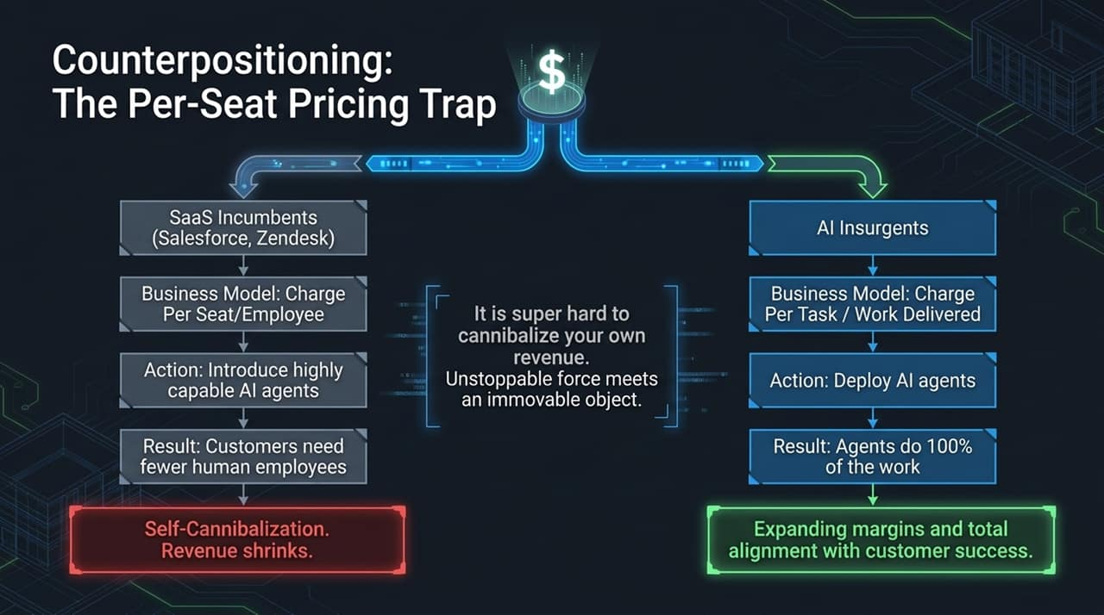
Notes:
Counterpositioning occurs when a startup adopts a business model that an incumbent cannot copy because doing so would cannibalize their core business.
SaaS Incumbents (Salesforce, Zendesk, Intercom) charge per human seat/employee. If they build truly capable AI agents that automate 80% of human work, their customers need fewer seats—shrinking the incumbent's revenue. They face an existential dilemma: self-cannibalization vs. stagnation.
AI Insurgents charge per task or work delivered. As agents complete 100% of the work, margins expand and incentives align directly with customer success.

Slide 8
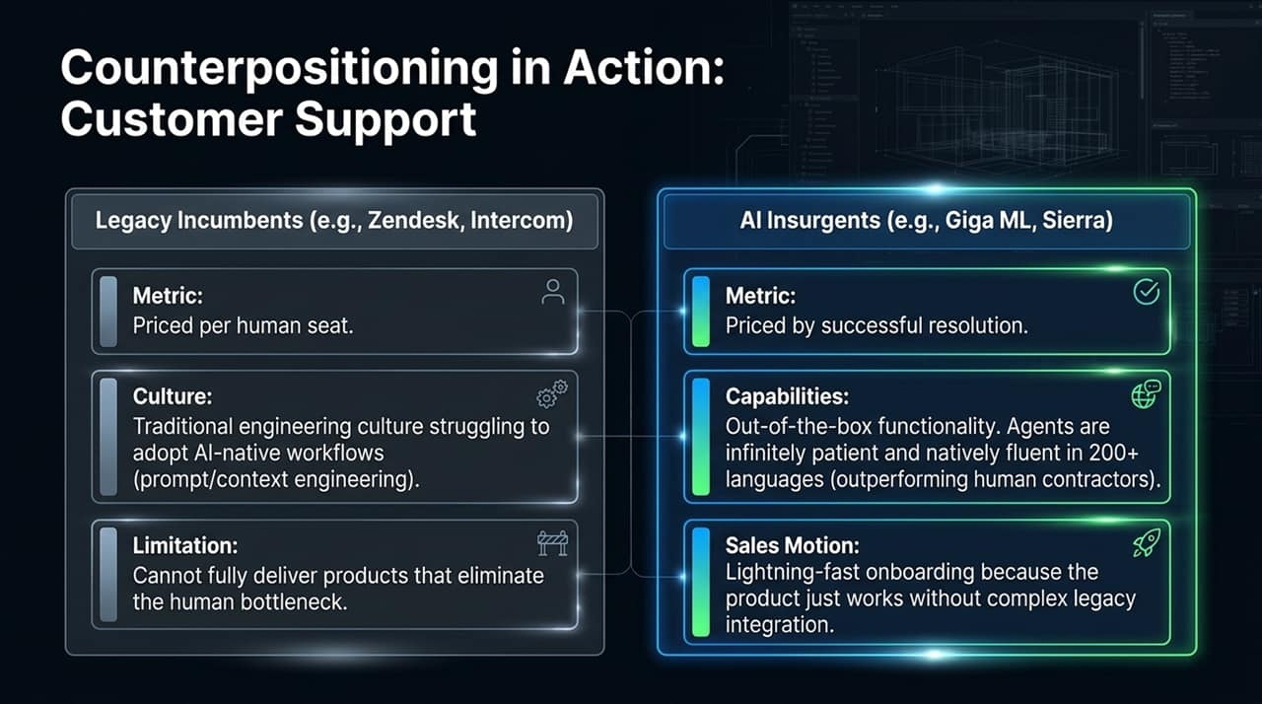
Notes:
Let's look at how this plays out specifically in Customer Support:
Legacy Incumbents (Zendesk, Intercom): Bound by per-seat pricing metrics and constrained by traditional engineering cultures struggling to adopt AI-native context engineering. They struggle to eliminate the human bottleneck.
AI Insurgents (Giga ML, Sierra): Charge purely by successful resolution. Their AI agents offer native fluency in 200+ languages, infinite patience, and out-of-the-box functionality. Their sales motion is fast because customers don't need complex legacy setup—they just pay for results.

Slide 9
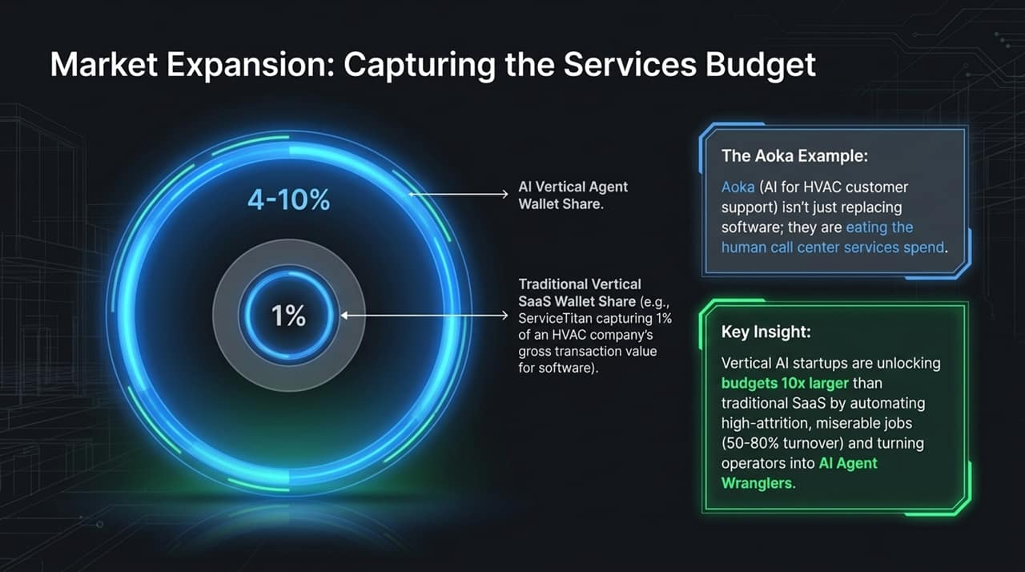
Notes:
Counterpositioning leads to a massive market expansion.
Traditional Vertical SaaS (like ServiceTitan) captures roughly 1% wallet share of an enterprise's revenue for pure software functionality.
AI Vertical Agents capture 4% to 10% wallet share because they don't just replace software—they eat into the human services and labor spend.
Look at Aoka (AI support for HVAC companies). Call centers suffer from 50–80% annual turnover because customer support in trades is grueling work. By deploying AI agents, Aoka unlocks 10x larger budgets while shifting human staff from miserable repetitive tasks to higher-level "AI Agent Wranglers."

Slide 10
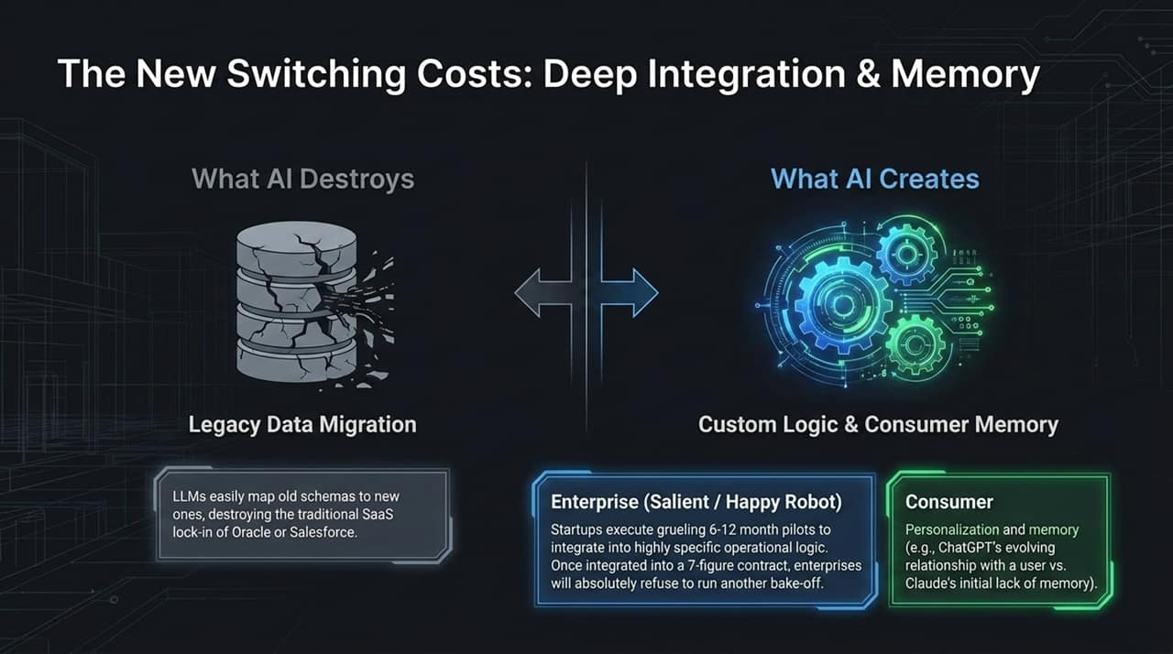
Notes:
Let's look closely at how Switching Costs have inverted:
What AI Destroys: Legacy data migration barriers. In the past, leaving Salesforce or Oracle was impossible due to schema lock-in. Today, LLMs and browser automation auto-map legacy schemas to new platforms effortlessly, destroying pure data lock-in.
What AI Creates: Deep operational workflow integration and memory.
In Enterprise (Salient / Happy Robot): Startups execute grueling 6-12 month pilots to tailor agent logic to exact enterprise workflows. Once integrated into a 7-figure contract, no executive will run another vendor bake-off.
In Consumer: Personalized relationship history and memory (e.g., ChatGPT knowing your context over time) creates sticky user retention.

Slide 11
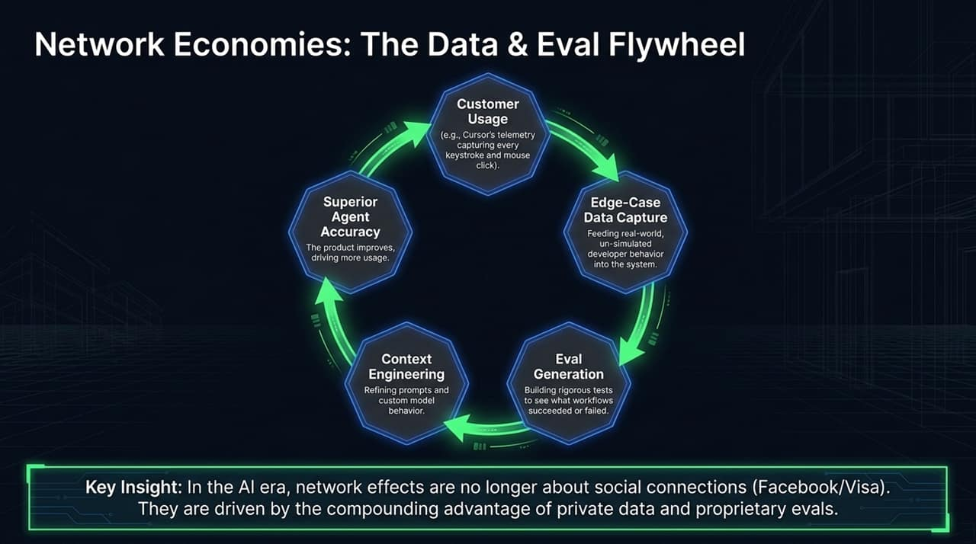
Notes:
Traditional Web2 network effects were driven by social connections (Facebook, Visa). In the AI era, network economies are driven by the Data & Eval Flywheel.
Here is the compounding loop:
Usage: High customer adoption (e.g., Cursor capturing developer telemetry, keystrokes, and clicks).
Edge-Case Capture: Gathering real-world, un-simulated user behavior.
Eval Generation: Creating rigorous automated test suites for what succeeded or failed.
Context Engineering: Refining prompts, RAG, and custom model weights.
Superior Accuracy: Leading right back to a better product, driving even more usage.

Slide 12
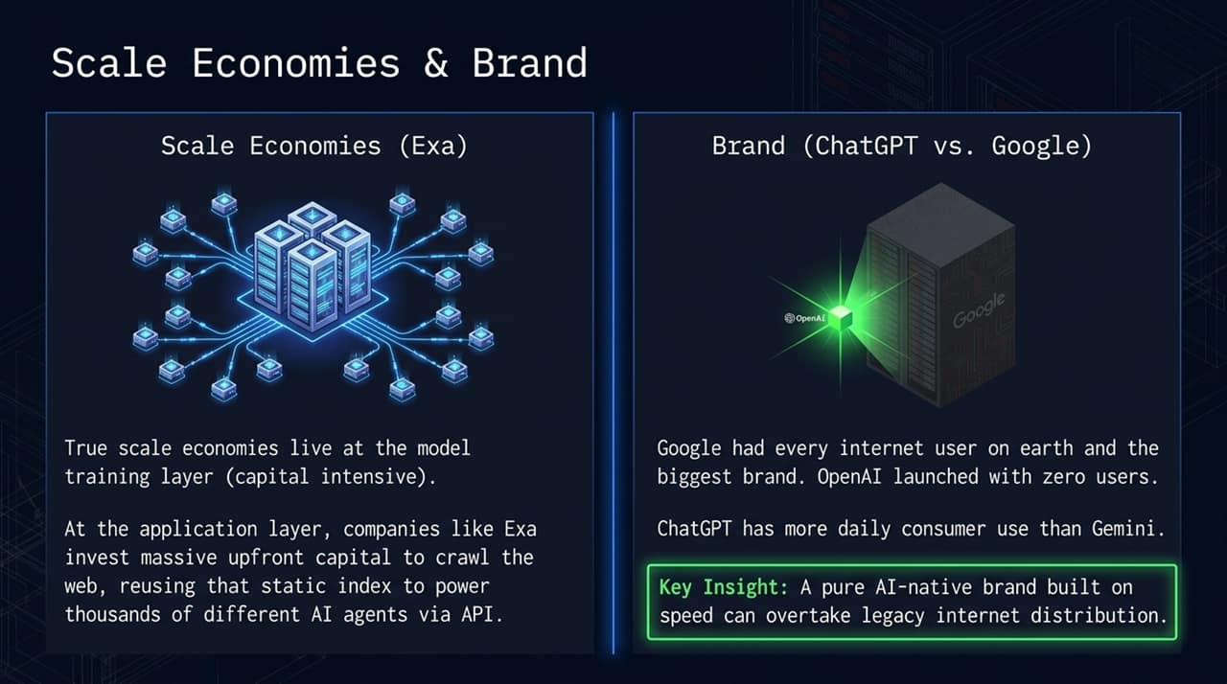
Notes:
Scale Economies: True scale economies are concentrated at the capital-intensive model layer. At the application layer, specialized infrastructure players like Exa invest heavy upfront capital to build a custom web crawl, then monetize by licensing that index via API to thousands of AI agents.
Brand Power (ChatGPT vs. Google): In late 2022, Google had every internet user on Earth and the world's most dominant brand. OpenAI started with zero users. Yet, through speed and consumer focus, ChatGPT built a brand so strong that it now sees higher daily consumer AI usage than Gemini. A fast-moving AI brand can defeat incumbent distribution advantages.

Slide 13
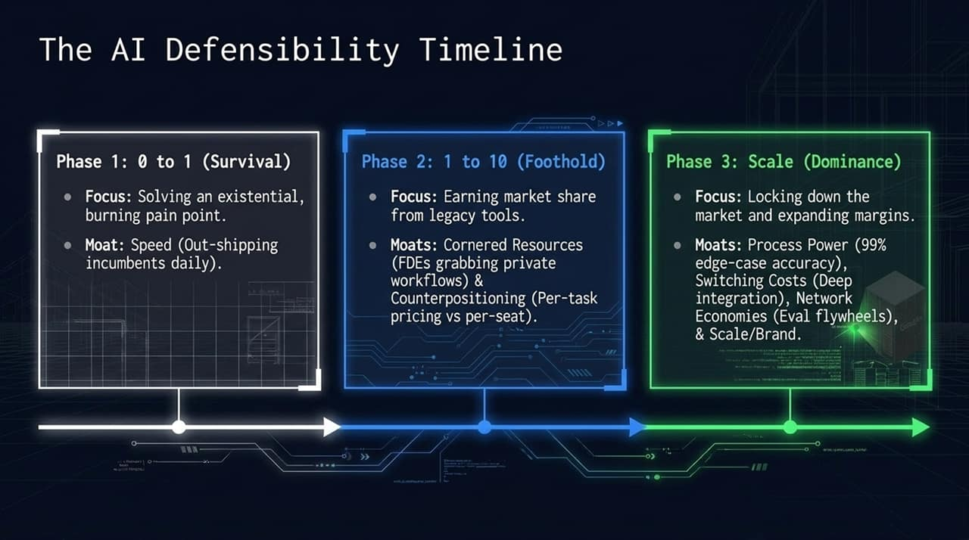
Notes:
To summarize how moats layer over time, keep this three-phase roadmap in mind:
Phase 1: 0 to 1 (Survival): Focus on existential customer pain. Moat: Speed (shipping daily).
Phase 2: 1 to 10 (Foothold): Steal market share from legacy tools. Moats: Cornered Resources (FDEs mining workflows) & Counterpositioning (per-task pricing).
Phase 3: Scale (Dominance): Lock down the market and expand margins. Moats: Process Power (99% accuracy), Switching Costs (deep integration), and Network Economies (eval flywheels).

Slide 14
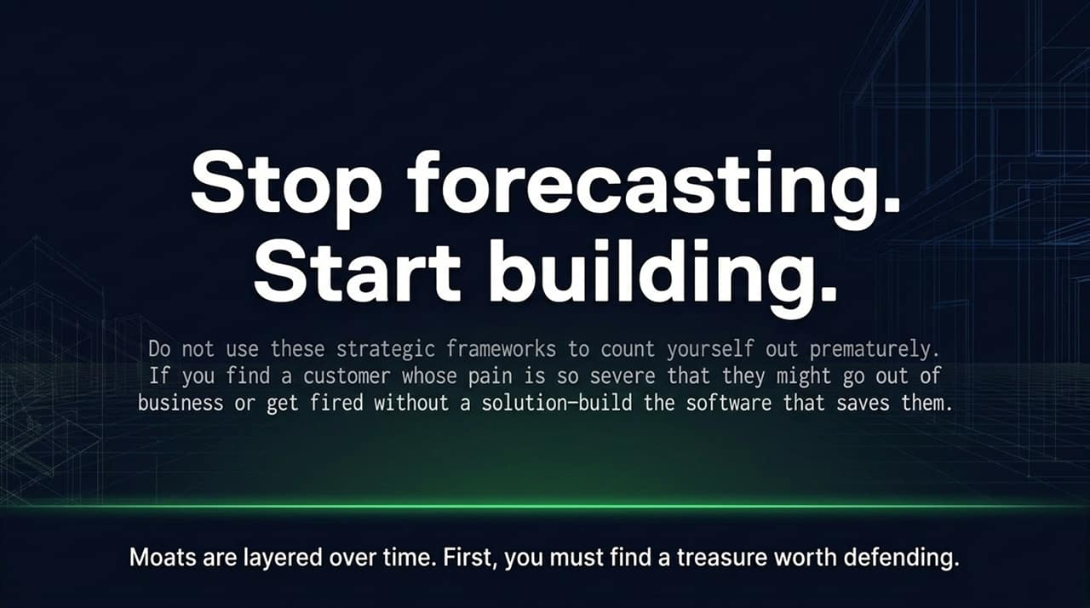
Notes:
The core message to take away today: Do not use strategy frameworks as an excuse for inaction.
If you analyze a market for 5 years out, you will talk yourself out of every great startup idea.
Find a customer whose pain is so severe that they fear for their job or business survival without a solution—and build the software that saves them.
Moats are layered over time. First, you must uncover a treasure worth defending.

Slide 15
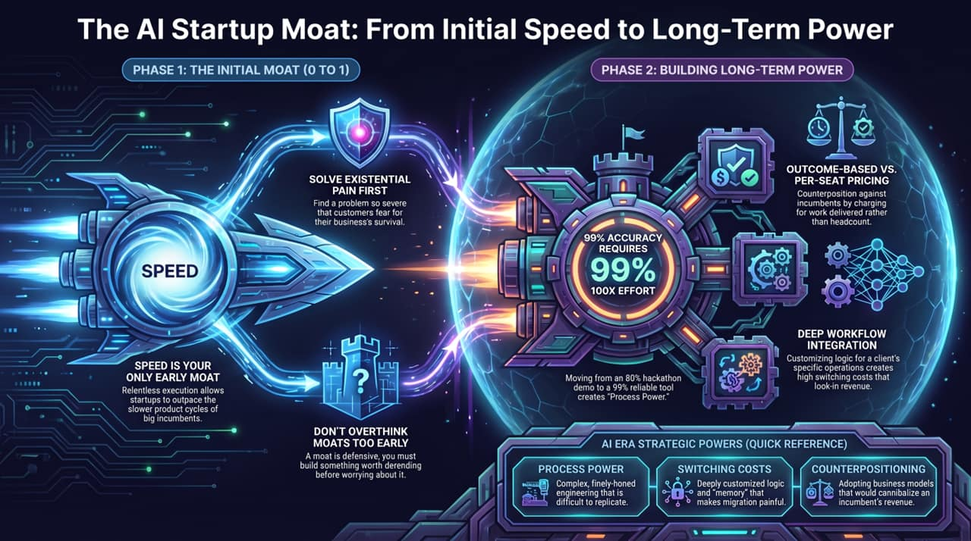
Notes:
This reference card summarizes the strategic evolution for your quick reference:
Initial Moats (Phase 1): Driven by Relentless Speed, solving existential pain, and ignoring premature moat anxiety.
Long-Term Power (Phases 2 & 3):
Process Power: 100x effort to bridge the 80%-to-99% accuracy gap.
Counterpositioning: Outcome-based pricing vs. per-seat legacy pricing.
Switching Costs: Deep workflow integrations and customized logic lock-in.
Focus on execution first, and the powers will follow.

